Slide 1

Basic Details of the Team and Problem Statement
Ministry/Organization Name/Student Innovation: Ministry of Environment.
PS Code:SIH1392
Problem Statement Title: E-Waste Facility Locator.
Team Name:Inspiro
Team Leader Name: Trinadh Matta.
Institute Code (AISHE):C-18104
Institute Name: Seshadri Rao Gudlavalleru Engineering College
Theme Name:Smart Automation

Slide 2
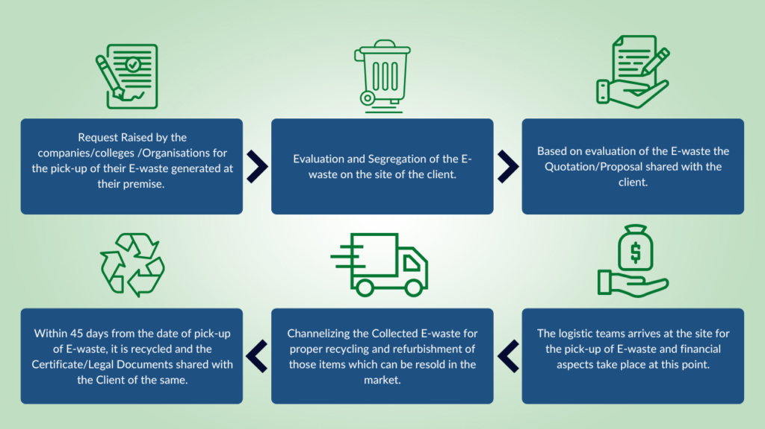
Idea/Approach Details
Add process flow chart or simulated image of prototype or any relevant image related to your idea
Idea/Solution/Prototype:
PROBLEMS:
1.Environmental pollutions
2.Lack of awareness
3.Lack of recycling centers
Solutions:
1.reduce,reuse,recycle
2,public awareness campaigns
3.More recycling collection centers
4.Business strategy
5.Platform for sending our e-waste
Technology stack :
HTML & CSS
JAVASCRIPT
NODEJS
OPEN CV
DJANGO

Slide 3
Idea/Approach Details
Use Cases :
Dependencies :
User Authentication: If users can create accounts, log in, or leave reviews, the website may depend on user authentication systems and databases to store user information securely.
Geolocation Services: To pinpoint the user's location and provide a list of nearby e-waste recycling centers, the website may depend on geolocation services like GPS or IP address-based location.
Database of Recycling Centers: A comprehensive and up-to-date database of e-waste recycling centers is essential. This database may need regular updates to include new centers or remove closed ones.
Web Hosting and Server: The website must be hosted on servers capable of handling traffic and providing a responsive user experience. Dependence on a reliable web hosting provider is crucial.
Programming Languages: The website is typically built using web development languages like HTML, CSS, JavaScript, and possibly server-side languages like PHP, Python, or Ruby.
User Registration and Profile Creation:
Users can register by providing their basic information.
Users can set preferences like pick-up schedules or preferred recycling centers.
E-Waste Inventory Submission:
Users can list the types, brands, and quantity of electronic items they want to recycle.
. Locate Nearby E-Waste Drop-off Points:
Integrated maps feature shows the nearest e-waste recycling centers.
Users can drop off their e-waste if they prefer.
Rewards and Incentives:
Users earn points for every item recycled which can be redeemed for eco-friendly products, discount vouchers, or even cashback.

Slide 4

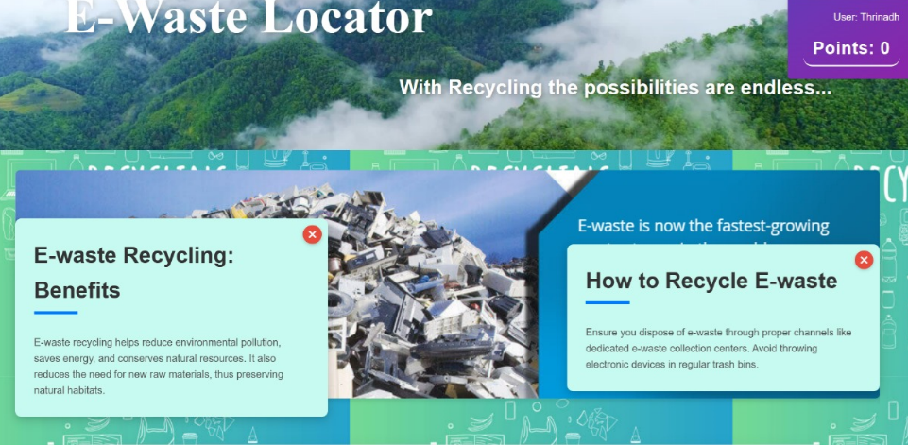
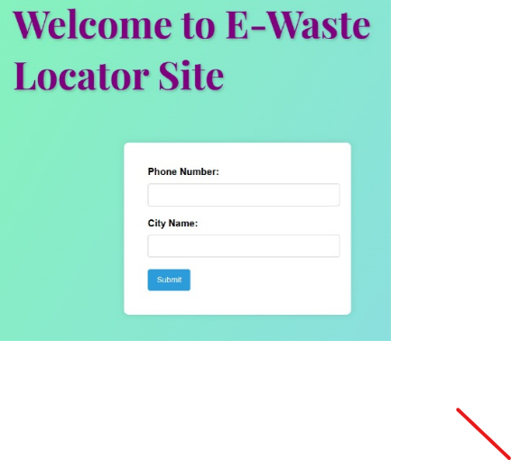
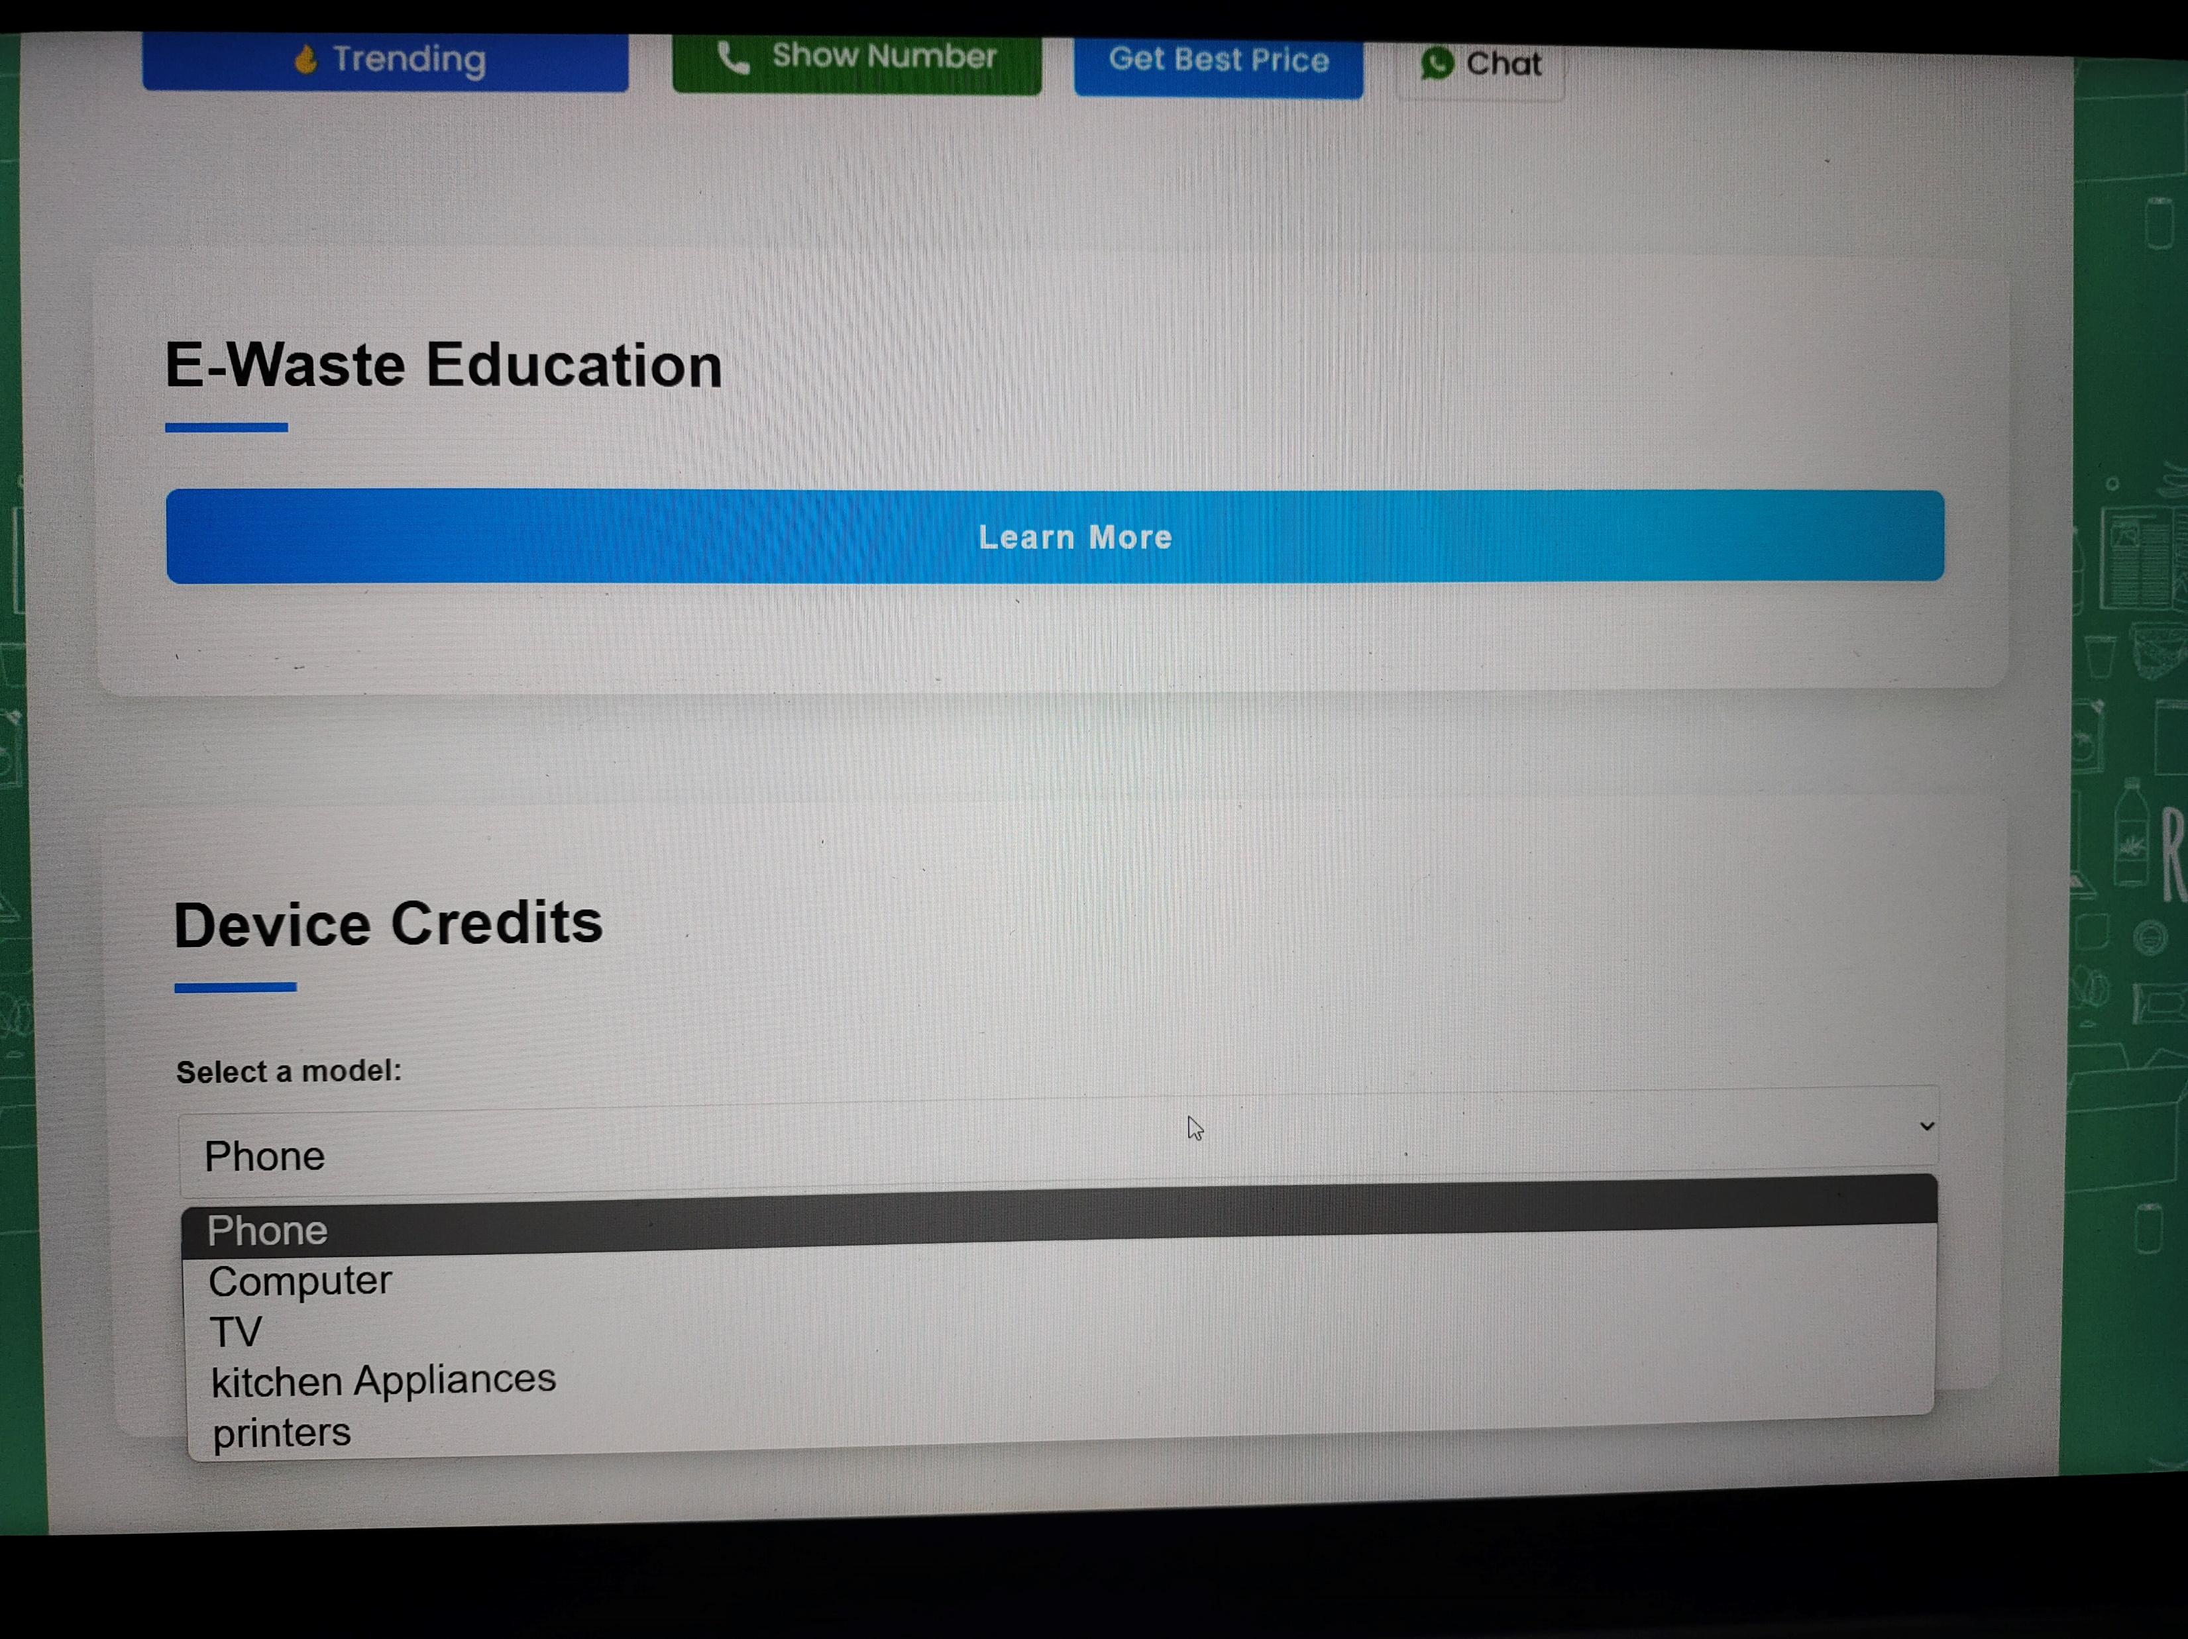
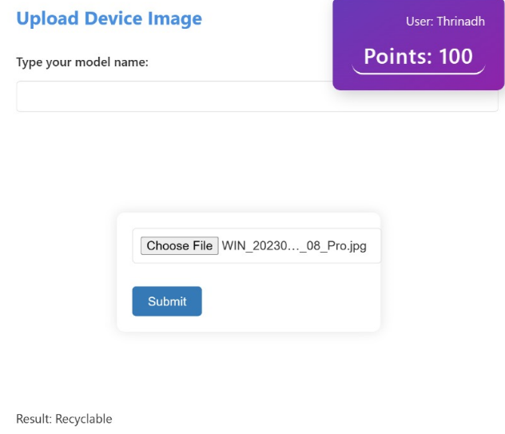
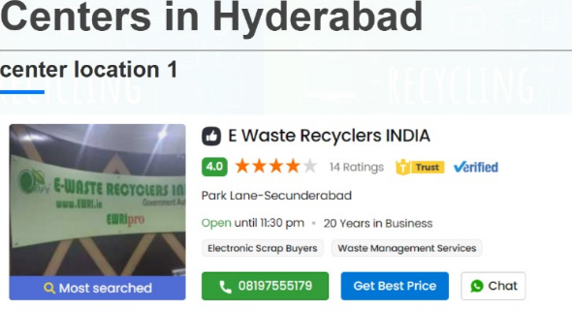
Working of our Website
Working of Website
2
1
Educational pop-ups
3
4

Slide 5
Team Member Details
Team Leader Name: M.Thrinadh
Branch :Btech Stream :AI &DS Year :3rd
Team Member 1 Name: Y.Gnan Kishore
Branch :Btech Stream :AI & DS Year :3rd
Team Member 2 Name: S.Yaswanth
Branch :Btech Stream :AI & DS Year :3rd
Team Member 3 Name: M.Poojitha
Branch :Btech Stream :AI & DS Year :3rd
Team Member 4 Name: V.Jai Srinivas
Branch :Btech Stream :AI & DS Year :3rd
Team Member 5 Name: M.Neeraja
Branch :Btech Stream :CSE Year :3rd
Team Mentor 1 Name: Mr.K.Ashok Reddy
Category :Academic Expertise :AIML,Business Statistics Domain Experience :11 Years
Team Mentor 2 Name: Dr.B.Mahesh Babu
Category :Academic Expertise :AI,Electrical Domain Experience :12 Years

